Slide 1

Frameworks, Extensions and More (oh my)
Darkside of Monogame
Simon Jackson
Author and Microsoft MVP
@SimonDarksidej

Slide 2
What to consider when picking up MonoGame?
From Scratch
Code is your own
Use a Framework
Building on Giants shoulders
Grab an Engine
Steeper learning curve
Chose what to use
Time consuming
Editor Support?

Slide 3
What is available out there?
Engines
DigitalRune
Frameworks / Extensions
Nez (Prime31)
MonoGame.Extensions
UI Frameworks
EmptyKeys
Geon.UI
Gui4U
Ruminate
*Not an extensive list
There may be more!

Slide 4
Engines and Frameworks

Slide 5

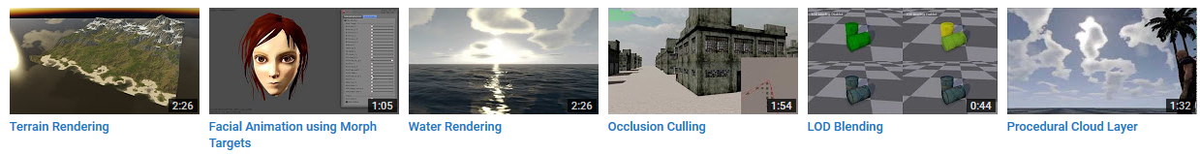
DigitalRune https://github.com/DigitalRune/DigitalRune
Formally a paid for XNA Engine
Updated to support MonoGame and Open Sourced in June 2016
Fully documented with an extensive set of features
Large array of samples available for several platforms
An experimental editor is also available

Slide 6

Nez (aka Prime31) https://github.com/prime31/Nez
Lightweight 2D framework that sits on top of MonoGame
Extensive set of features, including:
Scene/Entity/Component system
Farseer Physics (based on Box2D) integration
In-game Component inspector
Pathfinding support
Deferred lighting engine & kick-ass particle system
& much much more
Fully open source with a large backing & full documentation

Slide 7

MonoGame.Extended https://github.com/craftworkgames/MonoGame.Extended
An open source extension library for MonoGame. A collection of classes and extensions to make it easier to make games with MonoGame
Tons of features including custom Content Importers
Available via source and NuGet (same as MG)
Uses the MonoGame forum using it’s own category (one big happy family)
Actively developed in line with MG releases
Cooperative development with the Prime31 team.
Growing list of samples and examples

Slide 8
UI Frameworks

Slide 9
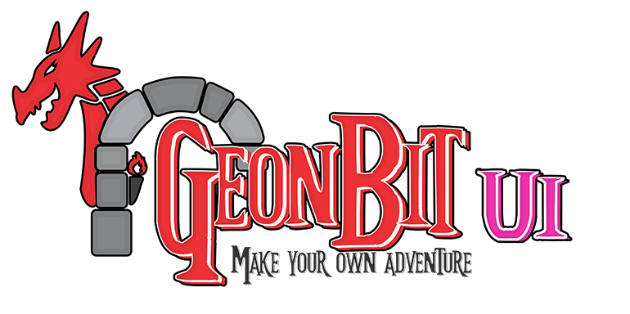

Actively developed UI Frameworks
Emptykeys
http://emptykeys.com/ui_library
Geon.UI
https://github.com/RonenNess/GeonBit.UI
Empty Keys UI is Portable Class Library for .NET or Mono. On top of that it supports 5 engines - CocosSharp, Xenko, Synapse Gaming SunBurn, MonoGame and FNA
Includes:
XAML style code generation
Styles, Themes, MVVM and Animations
DPI Aware (auto-scales)
GeonBit.UI is the UI / HUD system of the GeonBit engine, exported as an independent MonoGame extension under the MIT license.
Full featured UI system, including Events, Panels, scaling and automatic layout support
Includes over 40 built-in icon sets
Programmatic API

Slide 10


Alternative UI Frameworks
Gui4U
https://gui4u.codeplex.com/ - LU 2015
Ruminate UI (formally XNAGUI)
https://xnagui.codeplex.com/ - LU 2014
Built and extended from XNA SimpleGUI
Great system for simple messages, basic controls
Includes WinForms support for editor projects
Basic widget / control framework
Includes separate repo sample project
Quick and easy to implement
May need a little work :S

Slide 11
Other notables

Slide 12


Other notable frameworks
ProtoBuild A Package / Solution generation project - https://protobuild.org/
Used by MonoGame
Breaks the dependency between project/solution and code
Also includes it’s own optional package builder solution
Sunburn Gaming Engine (sadly no updates since late 2014) http://www.synapsegaming.com/
A fantastic engine solution
Included base MonoGame support (http://bit.ly/2j2GVhQ)
Platform framework is still free

Slide 13
Thanks for watching
Darkside of Monogame
Simon Jackson
Author and Microsoft MVP
@SimonDarksidej

